Slide 1
General tips & tricks
CSC 301: Jesse Hockenbury

Slide 2
Administrative
Questions about using git
General questions about the final project

Slide 3
Tips covered
Using HTML templating techniques for easier design changes and consistency
Creating / altering MySQL tables

Slide 4
What is an HTML template
There are parts of an HTML website will be the same on every page, right?
Think about INF 286 where each group member had to use the exact same HTML

Slide 5
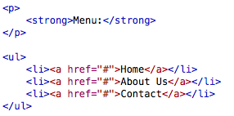
Include template parts
Common elements for a web page can be placed in their own file and then included into the larger page.

Slide 6
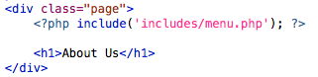
Including components

Slide 7
Creating a Mysql table
Creating a MySQL table can be done with MySQL Workbench
http://www.quackit.com/mysql/workbench/create_a_table.cfm

Slide 10
Notes:
May have to do a Refresh All

Slide 11
Inserting / update data

Slide 12
Project: where to start
Coming up with an idea (Write bulleted list of desired features)
Think about the different ”objects” that will be present in your application
Consider creating an ER diagram… or at least a list of tables and the properties, review Chapter 6 of the textbook

Slide 13
Project: Process
Consider beginning by creating the files you will use and place comments in them like I do for the homework
Create an HTML template for your pages
Develop features sequentially so you don’t become overwhelmed

Slide 14
Project: General
Get started early
I would prefer concept questions versus syntax questions
Get the information of someone you know in the class that can possibly assist you
Potentially bounce ideas off one another
Challenge yourself, its how you will truly learn

Slide 15
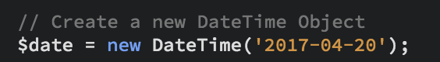
Dates in PHP
In PHP there is a class called DateTime. This class will allow for the creation of a date/time object that can be modified, formatted and printed to the screen.
The constructor takes one optional parameter which is a date/time stamp as a string. If nothing is passed the current date/time of the server will be used unless a time zone is defined
Notes:
If pass nothing will ge get current date time from server

Slide 16
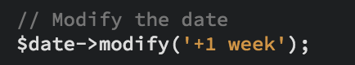
Date Modify
The modify method of the DateTime class allows you to adjust the date and time of the object
The syntax is unique in that it understands English as its parameter such as +1 day or +1 week.

Slide 17
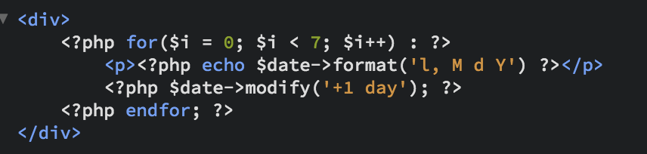
Date Format
http://php.net/manual/en/function.date.php
The format method provides a string representation of the date object based upon the format string provided (format options can be found at link above)
Notes:
See table for dare formats

Slide 18
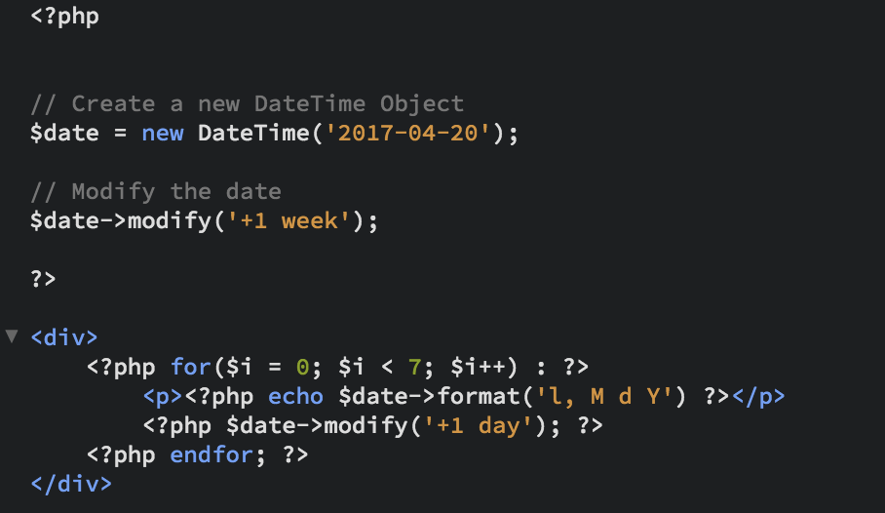

Slide 19
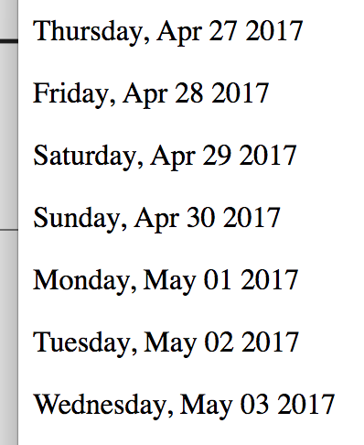
Results

